Slide 1



SMART SEGREGATION
18it097(PRINCE PATEL)
GUIDED BY : PROF. HARSH PATEL

Slide 2
Introduction
In most of the places in India, garbage is dumped as one, mixing degradable and non-degradable wastes, causing the spread of a lot of epidemics. In our daily life, we see the garbage bins being overfull and all the garbage spills out resulting in pollution. Due to population growth, industrialization, and economic growth, a trend. of significant increase in Municipal Solid Waste (MSW) generation has been recorded worldwide. In India, the total generated waste is expected to cross 800,000 tons in 2012. This figure is expected to grow at a rate of 30 – 50 % every year. With correspondence to the Swachh Bharath Scheme of our Honourable Prime Minister to make India clean and green, this SMART SEGRIGATION is an initiative taken by us to make it more commendable.

Slide 3
Objectives
To Develop a model for segregate the waste properly.
To use Arduino(IDE) software to generate a computer program in order to get signal for the real time

Slide 4

SOFTWARE REQUIREMENTS
ARDUINO IDE

Slide 5
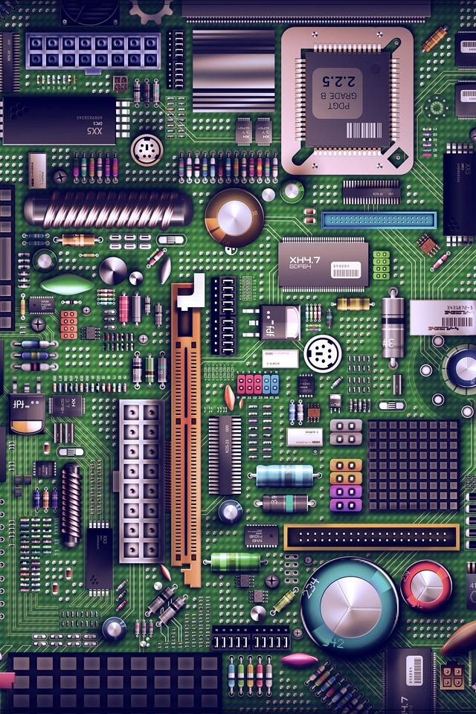
HARDWARE REQUIREMENTS
ARDUINO NANO
ULTRASONIC SENSOR HC-SR04
MICRO SD CARD ADAPTER
BREADBOARD
JUMPER WIRES

Slide 6
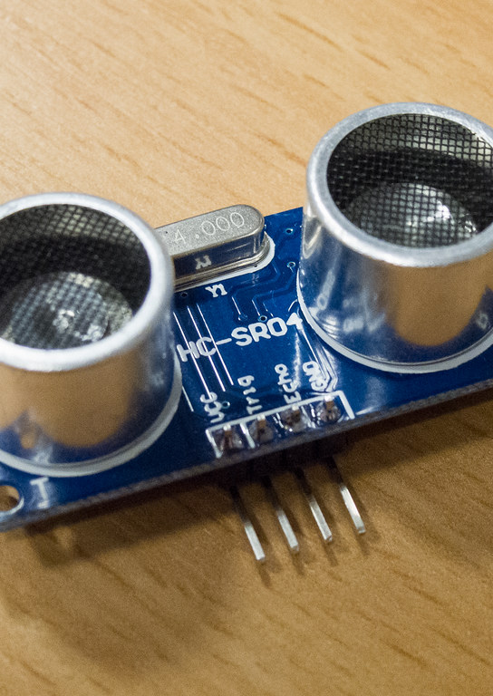
Ultrasonic sensor
OPERATING VOLTAGE: +5V
THEORETICAL MEASURING DISTANCE: 2CM TO 450CM
ACCURACY: 3MM
OPERATING FREQUENCY: 40HZ

Slide 7
ULTRASONIC SENSOR
THE ULTRASONIC SENSOR MEASURE DISTANCE BY USING ULTRASONIC WAVES IT EMITS AN ULTRASONIC WAVE AND RECEIVES THE WAVE REFLECTED BACK FROM THE OBJECT
THE HC-SRO4 ULTRASONIC SENSOR IS A 4 PIN MODULE, PINS ARE VCC TRIGGER ECHO AND GROUND
THE ULTRASONIC SENSOR WORKS ON SIMPLE FORMULA DISTANCE = SPEED X TIME
THE TRANSMITTER TRANSMITS AN WAVE THIS WAVE TRAVELS IN AIR AND WHEN IT GETS OBJECTED BY ANY MATERIAL IT GETS REFLECTED BACK TOWARD THE SENSOR AND OBSERVED BY THE RECEIVER

Slide 8
APPLICATIONS
USED TO SEGRIGATE WASTE.
IT WILL STOP OVERFLOWING OF DUSTBINS.
THE FILLING AND CLEANING TIME OF SMART BIN WILL ALSO BE REDUCE THUS MAKING EMPTY AND CLEAN DUSTBINS AVAILABLE TO COMMON PEOPLE

Slide 9
LIMITATIONS
SENSOR NODES USED IN THE DUSTBINS HAVE LIMITED MEMORY SIZE.
THIS RESULTS INITIAL COST DUE TO EXPENSIVE SMART DUSTBINS COMPATRE TO OTHER METHODS.

Slide 10
references
https://www.wikipedia.org/
https://www.tutorialspoint.com/arduino/index.htm

